Slide 1
Concurrency and Parallelism
Basic Concepts in Computer Science

Slide 2
What is Parallelism?
Parallelism is performing multiple tasks or parts of a task at the same time
using multiple processors or CPU cores.
Goal: Faster execution and better performance.

Slide 3
Example of Parallelism
Real-life Example:
• A restaurant kitchen where chefs cook different dishes at the same time.
Computer Example:
A multi-core processor running multiple calculations at once. For example, when editing a video:
One core processes video frames
Another core applies effects
Another core handles audio

Slide 4
Simple programming example: Processing a large dataset where different portions of the data are analyzed simultaneously using multiple CPU cores.
👉 In short, parallelism = doing many things at the same time to finish faster.

Slide 5
Scenario: A computer with 4 CPU cores
Time →
Core 1: [ Task A ]
Core 2: [ Task B ]
Core 3: [ Task C ]
Core 4: [ Task D ]
✅ All tasks run at the same time ✅ Requires multiple processors or cores

Slide 6
What is Concurrency?
Concurrency is handling multiple tasks at once by switching between them.
Tasks may not run simultaneously but appear to run at the same time.
Goal: Responsiveness and efficient task management.

Slide 7
Example of Concurrency
Real-life Example:
• A teacher managing different student concerns one at a time.
Computer Example:
• A single-core CPU running and playing music, browsing, and download a file by task switching.

Slide 8
Simple programming example: A web server handling multiple user requests by interleaving their execution rather than finishing one request before starting another.
👉 In short, concurrency = managing multiple tasks at once, while parallelism = executing multiple tasks at the same time.

Slide 9
Scenario: A computer with 1 CPU core
Time →
CPU: [ Task A ] → [ Task B ] → [ Task C ] → [ Task A ] → [ Task B ]
✅ Only one task runs at a time ✅ CPU switches tasks very fast (context switching) ✅ Tasks appear to run simultaneously

Slide 10
Concurrency vs Parallelism
Simple Visual Comparison
Simple Visual Comparison
Concept | Illustration Idea | Core Idea
Parallelism | Multiple workers working together | Same time execution
Concurrency | One worker multitasking | Task switching

Slide 11
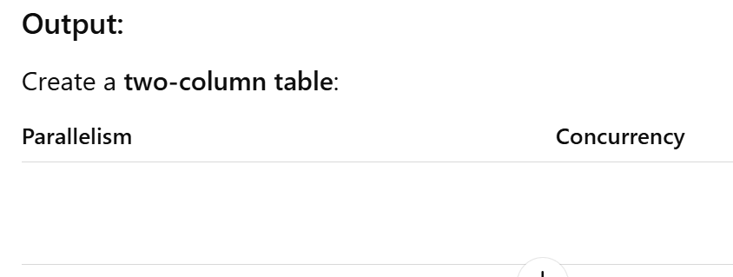
CLASS ACTIVITY
Instructions:
You will be given a list of scenarios. Classify each scenario as Parallelism or Concurrency.
Scenarios:
A quad-core CPU rendering a video using all cores at the same time
One cashier serving many customers by switching between them
Multiple printers printing different documents simultaneously
A single-core CPU running music, browser, and chat apps
Four students solving different parts of a group project at the same time

Slide 12
ANSWER

